Slide 1
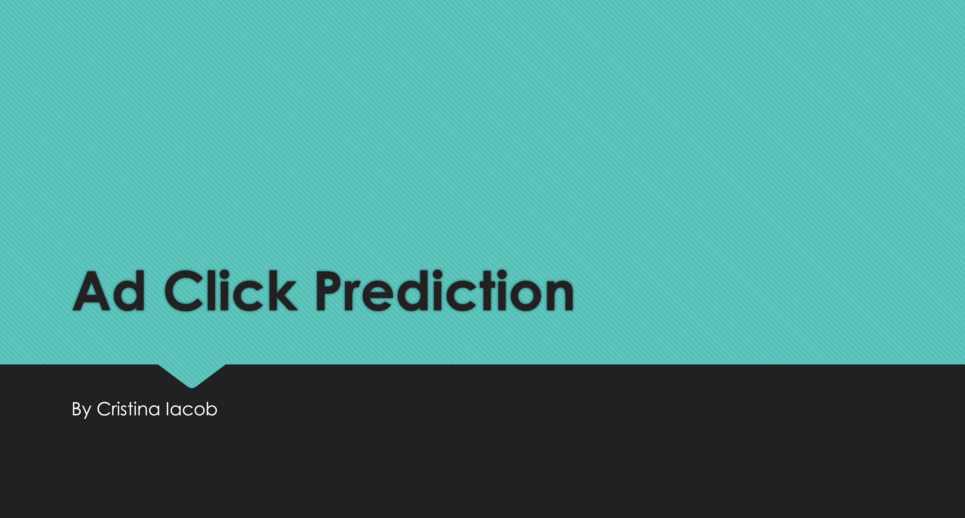


Slide 2
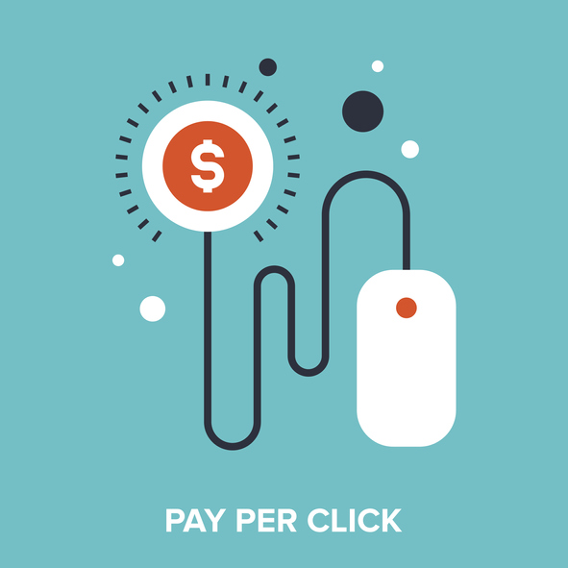
Goal
Explore the relationships between the predicting variables and label
Can we predict who is more likely to click an ad, based on the customer profile and ad headline?
Intended audience
Marketing/Sale teams
Product owners
Data source: https://www.kaggle.com/shubhamsarafo/advertising

Slide 3
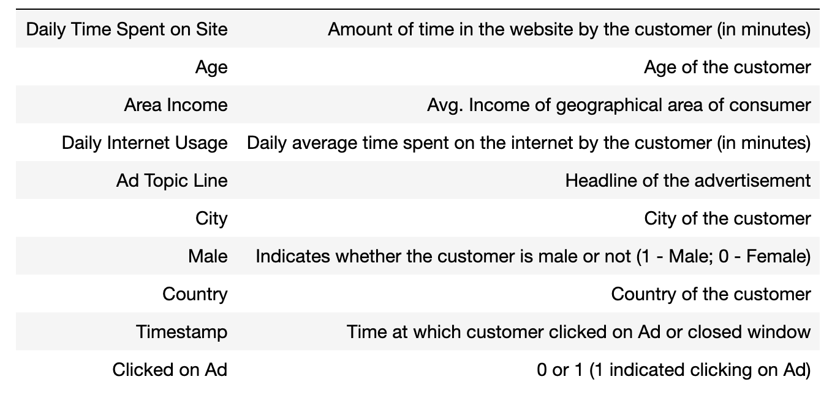
Data Description
Data set consists of 1000 observations and 10 features:
Data source: https://www.kaggle.com/shubhamsarafo/advertising

Slide 4
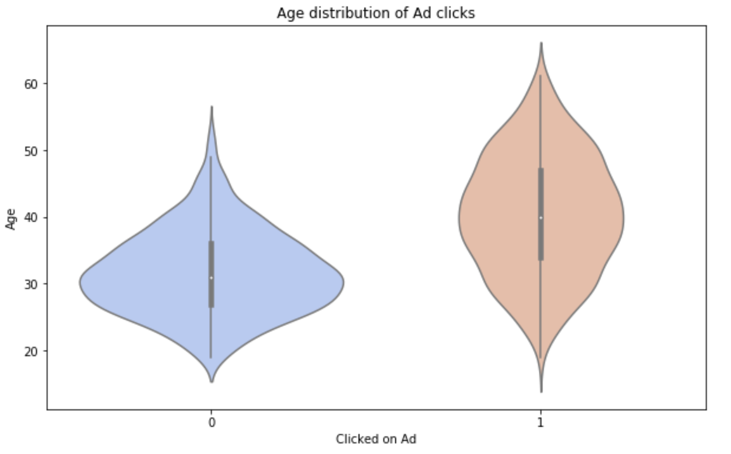
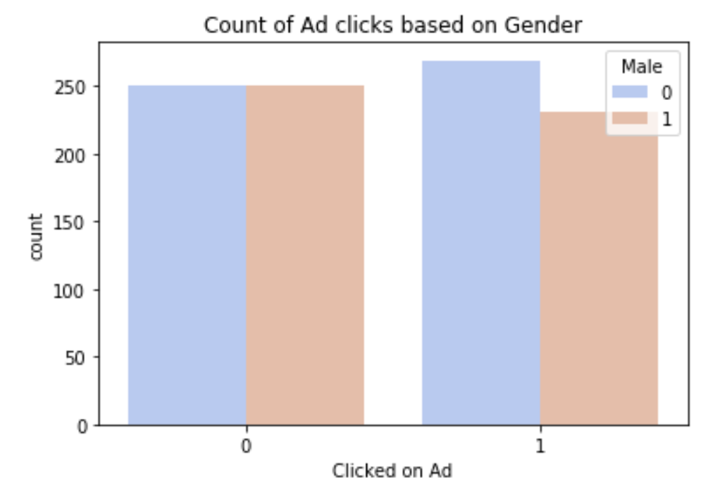
Visualizing relations between features and label
Which customers clicked more on an Ad?
Customers with an average around 40 years old are the most contributors to ad clicking.
Females tend to click more on Ads.
Data source: https://www.kaggle.com/shubhamsarafo/advertising

Slide 5
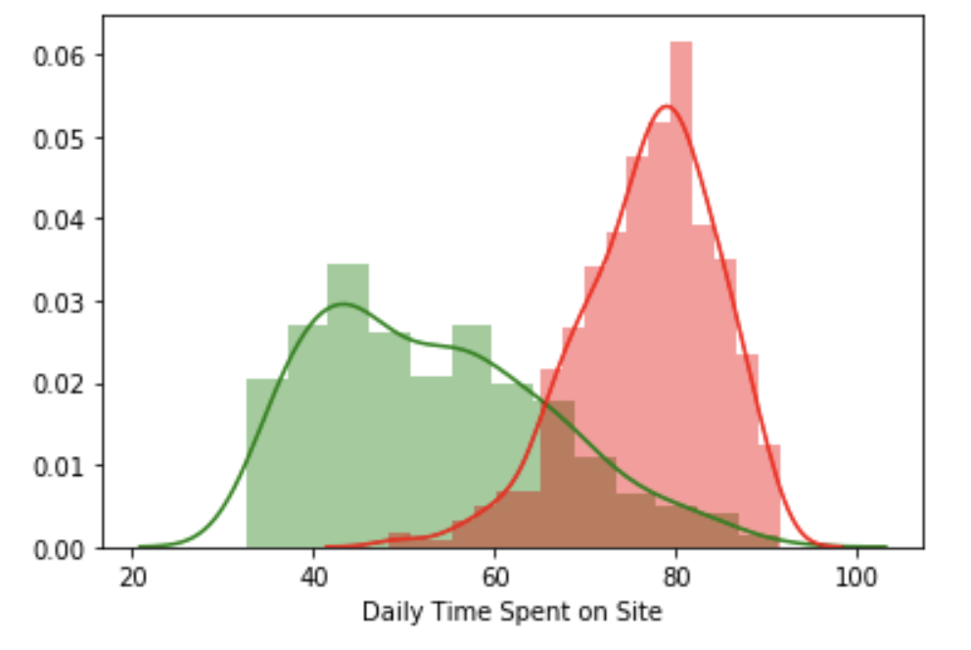
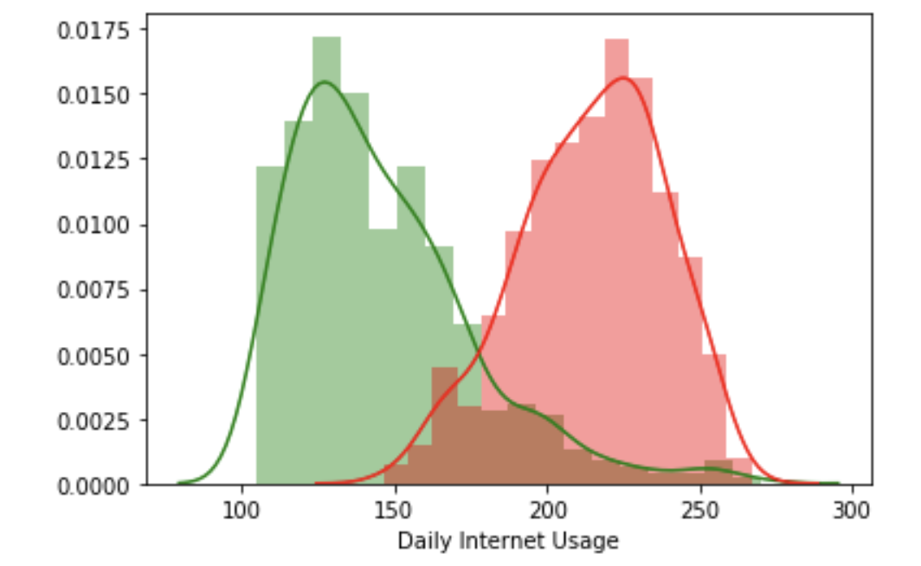
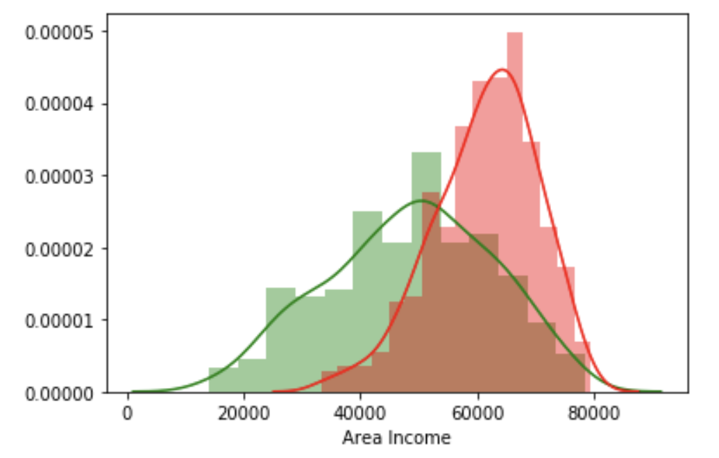
Visualizing relations between features and label (cont’d)
Which customers clicked more on an Ad?
Customers who spent less time on the site and/or browsing the internet
Customers from regions with a lower average income
Data source: https://www.kaggle.com/shubhamsarafo/advertising

Slide 6
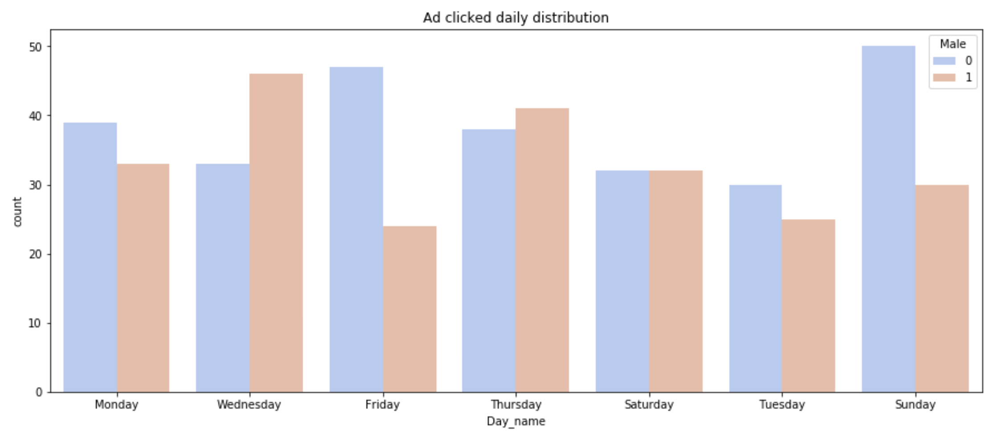
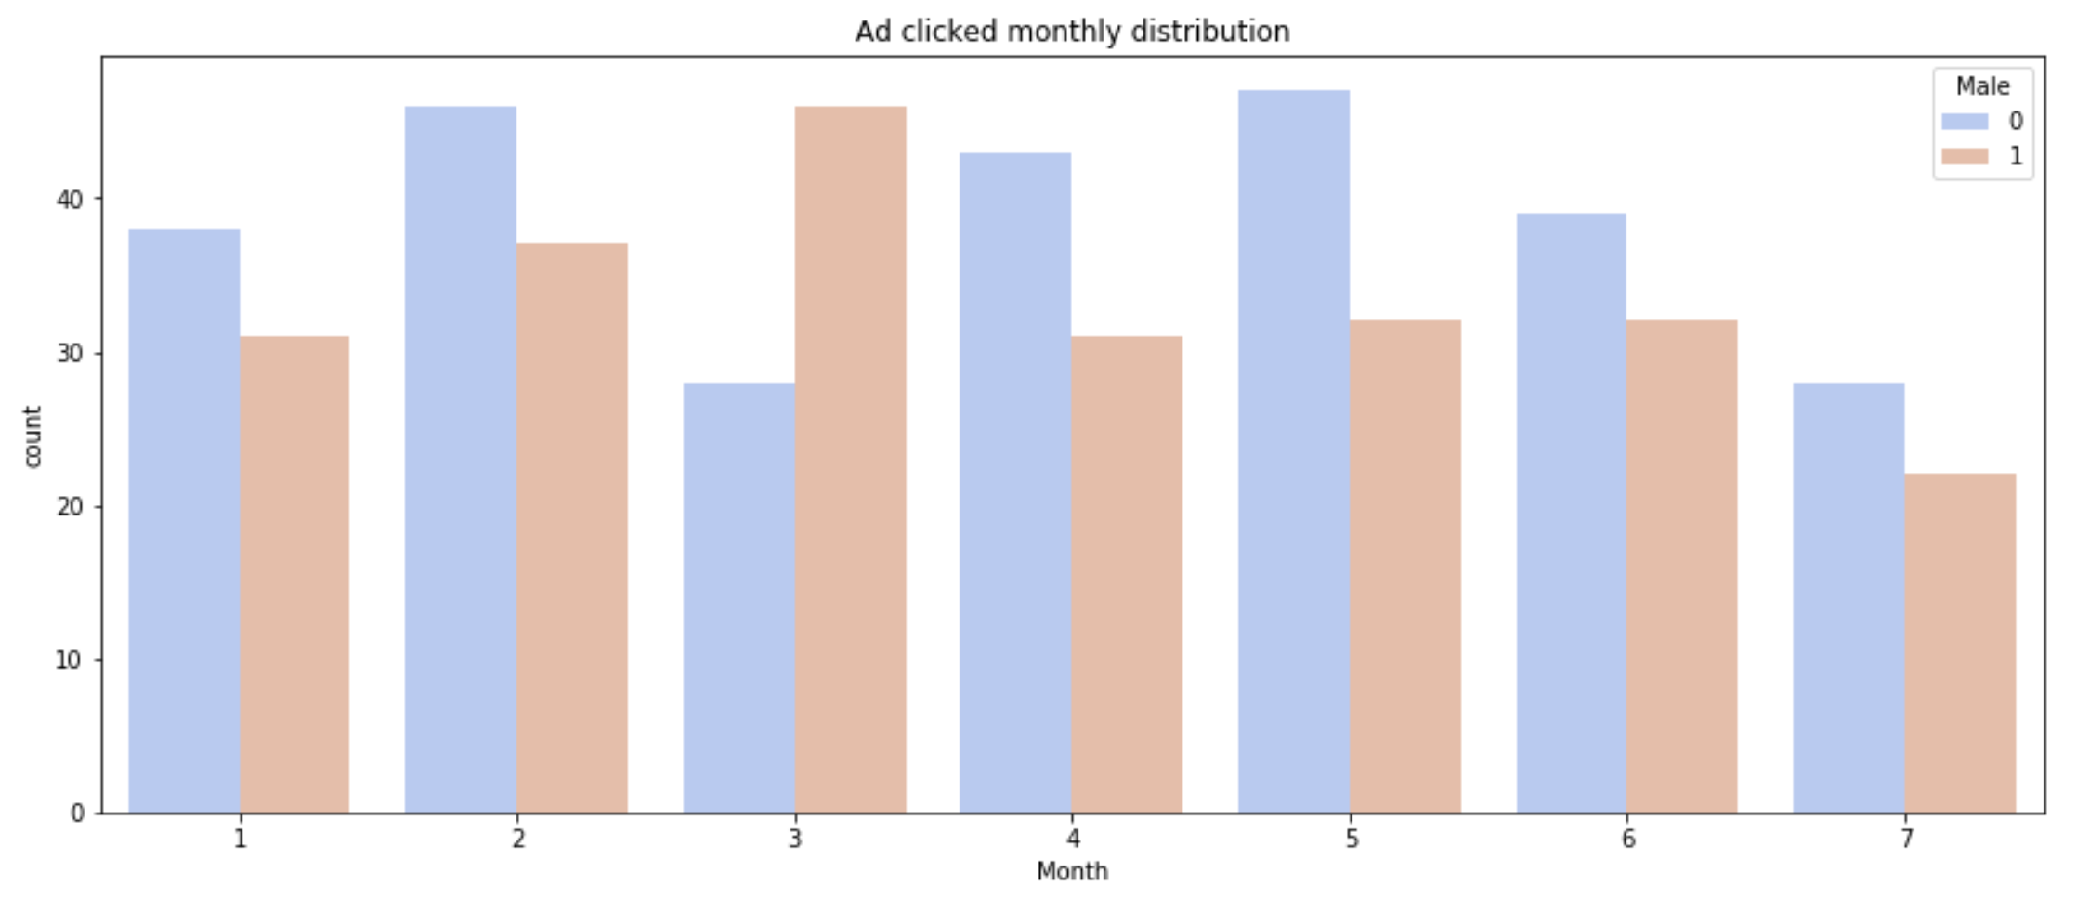
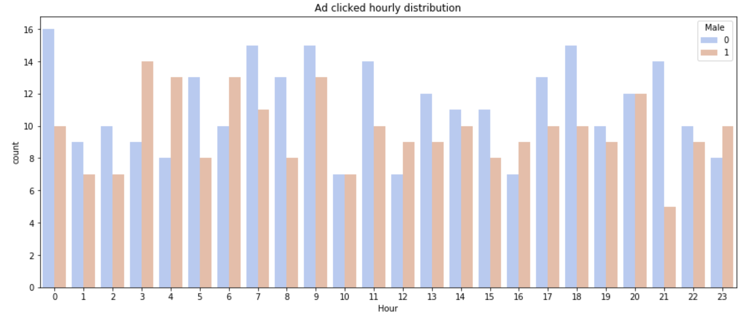
Visualizing relations between features and label (cont’d)
On which months /days/ hours customers clicked more on an Ad?
Data is only for January to July, 2016.
Uneven hourly/daily/monthly frequency, no realistic patterns however
Females are the main contributor on ad click except for March, Wednesdays and Thursdays
Data source: https://www.kaggle.com/shubhamsarafo/advertising

Slide 7
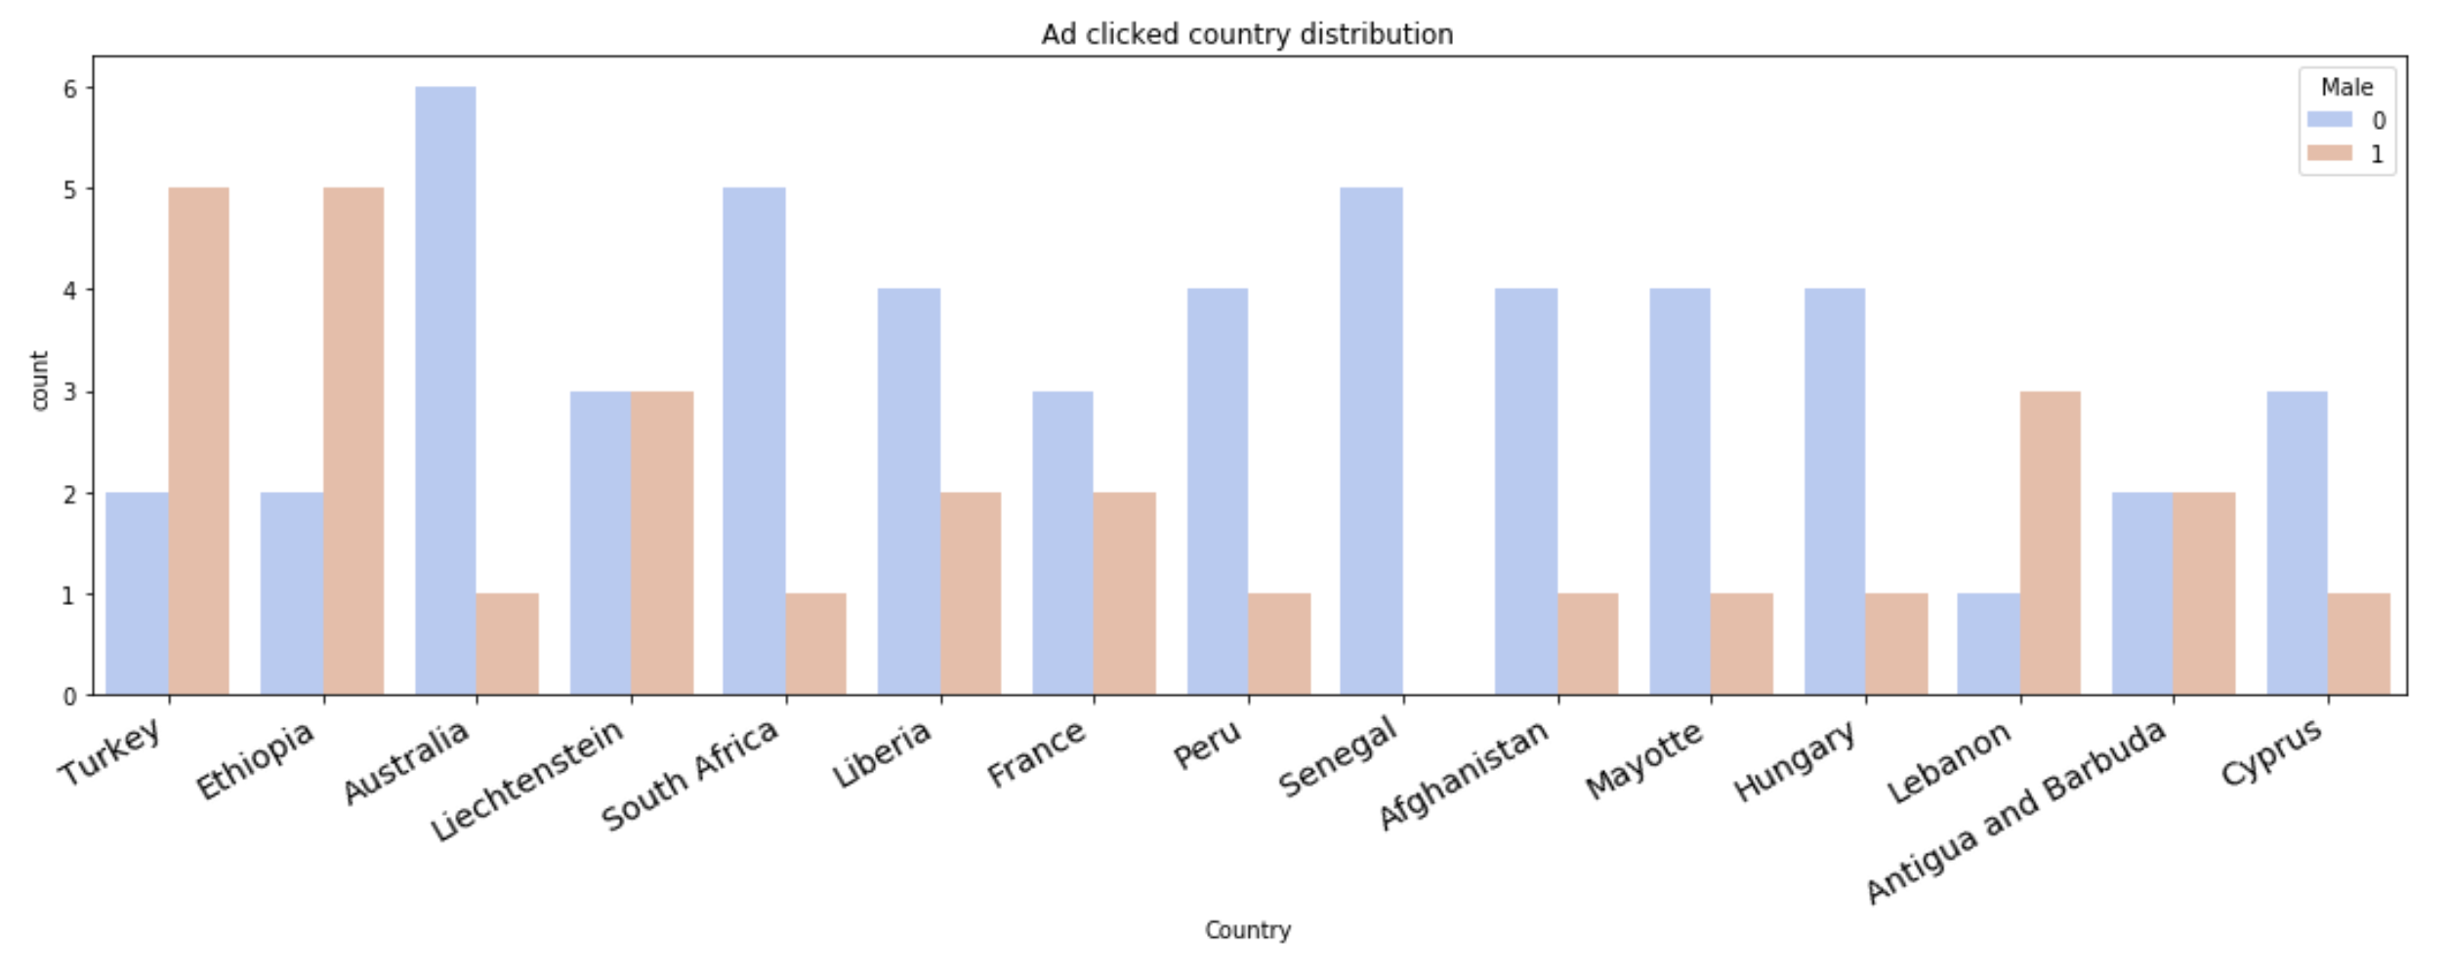
Visualizing relations between features and label (cont’d)
From which countries are customers clicking more on an Ad?
Customers are from 237 countries and 969 cities
Most developing countries and females are the active contributors.
Data source: https://www.kaggle.com/shubhamsarafo/advertising

Slide 8
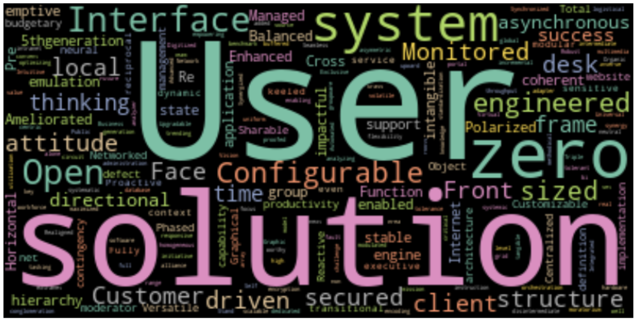
What about Ad headlines?
For the 1000 records there are 1000 unique Ad headlines
What about specific words from the Ad title?
Data source: https://www.kaggle.com/shubhamsarafo/advertising

Slide 9
Pre-processing & Modeling
Data:
Randomly split : 80% for Training and 20% for Testing
Numerical variables were scaled
Categorical variables were encoded
Selected Models:
Logistic Regression
K Nearest Neighbors Classifier
Random Forest Classifier
Gradient Boosting Classifier
Jupyter notebook: https://github.com/cristina-iacob/Predicting-Ad-Click/blob/main/AdClickPrediction.ipynb

Slide 10
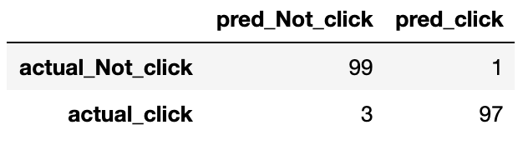
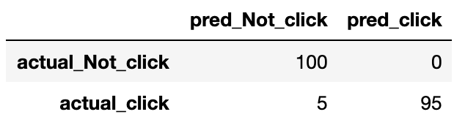
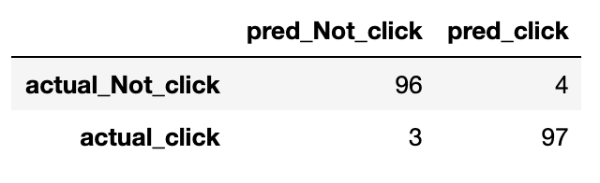
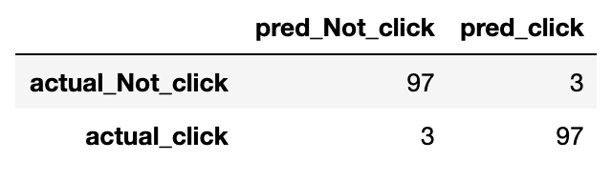
Results
Logistic Regression
K Nearest Neighbors Classifier
Random Forest Classifier
Gradient Boosting Classifier
Jupyter notebook: https://github.com/cristina-iacob/Predicting-Ad-Click/blob/main/AdClickPrediction.ipynb

Slide 11
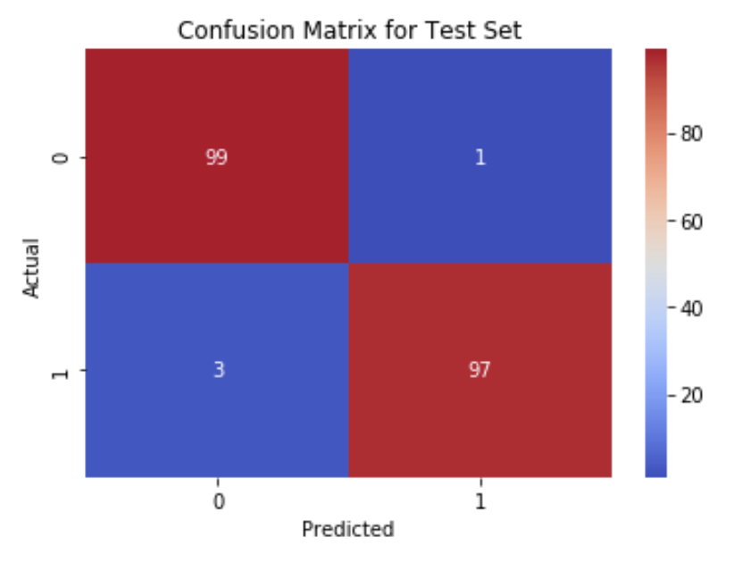
Results (cont’d)
Winner: Logistic Regression
Jupyter notebook: https://github.com/cristina-iacob/Predicting-Ad-Click/blob/main/AdClickPrediction.ipynb

Slide 12
Conclusions:
According to our analysis, customers who are more likely to click on an ad:
tend to have lower-medium income, between $40.000-$50.000
over 40 years-old
not spending too much time on the website or browsing the internet
Our model is able to predict with 97% precision the people who will click on the ad and 99% precision those who will not. This means that the model is a bit better to correctly predict people who will not click on an ad then those who will do.
Jupyter notebook: https://github.com/cristina-iacob/Predicting-Ad-Click/blob/main/AdClickPrediction.ipynb

Slide 13
Limitations and Next Steps
We had a limited amount of data: 1000 records, half of year
Ad titles were all unique (and non-sense) so they were not used in modeling; same for Countries and Cities
New data to include more information such as Education, Income, Marital Status, Ad categories
Have more testing data and adjust the models based on the new results
Jupyter notebook: https://github.com/cristina-iacob/Predicting-Ad-Click/blob/main/AdClickPrediction.ipynb

Slide 14
Questions?

Slide 15
Additional Resources

Slide 16
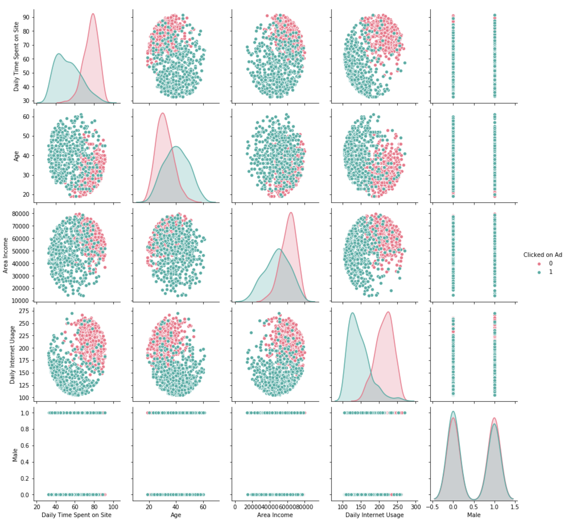
Numerical variables visualization

Slide 17
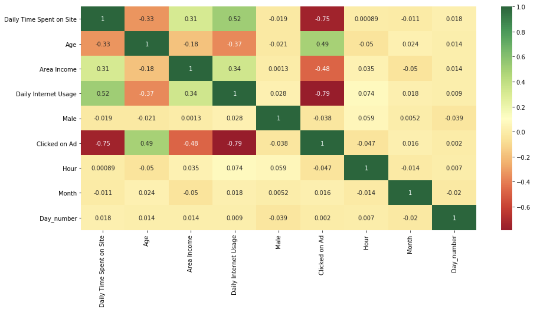
Correlation matrix
Jupyter notebook: https://github.com/cristina-iacob/Predicting-Ad-Click/blob/main/AdClickPrediction.ipynb

Slide 18
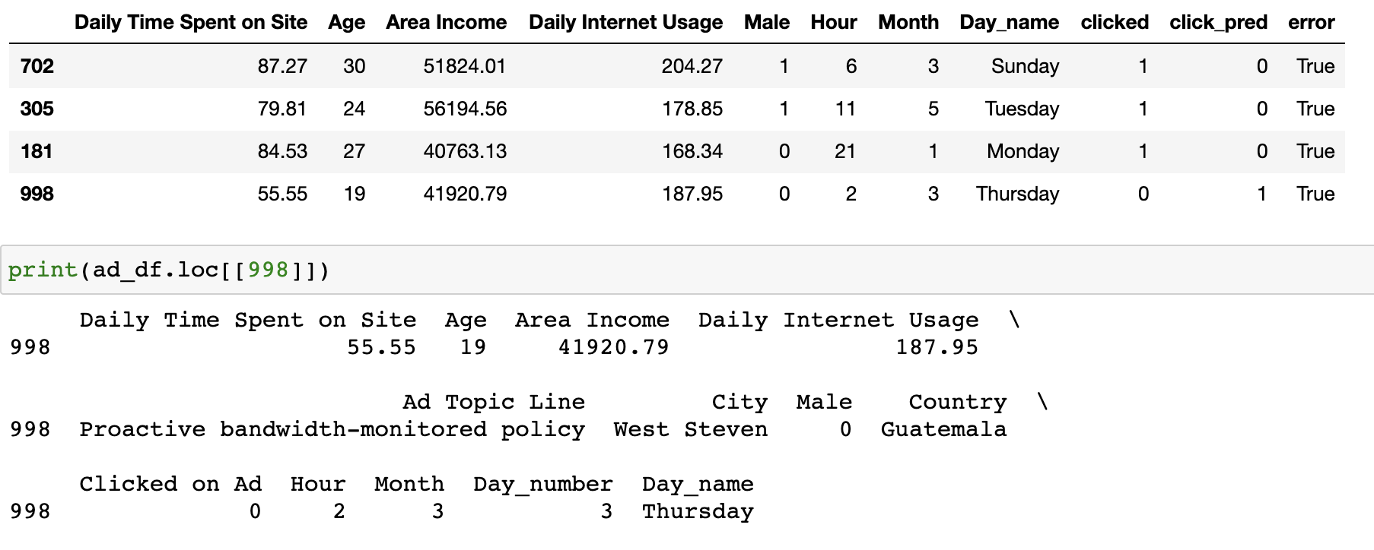
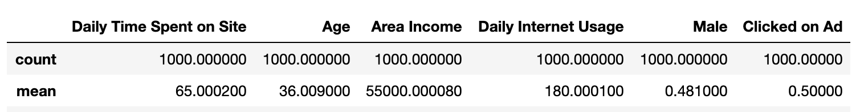
Visualizing our mistakes
Jupyter notebook: https://github.com/cristina-iacob/Predicting-Ad-Click/blob/main/AdClickPrediction.ipynb

Slide 19
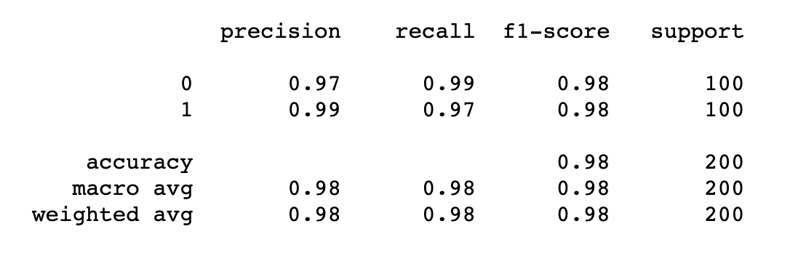
Logistic Regression Classification Report
Precision – outcomes correctly predicted: higher for predicting “ckick”
Recall – actual positives correctly identified: higher for predicting “no click”
F1 – score – weighted average of precision and recall: same value for predicting “click” and “no click “
Jupyter notebook: https://github.com/cristina-iacob/Predicting-Ad-Click/blob/main/AdClickPrediction.ipynb

